Slide 1
CSE 491 Presentation
Namespace: Cowboys
Notes:
Rajmeet

Slide 2
Our Contributions
GP agent Loop
LGPAgent
CGPAgent
Scavenger Queuing for training
GPAnalyzer
Profilers
Unit Tests
... and more
Notes:
Rajmeet

Slide 3
What the Heck is GP?
Notes:
Aman

Slide 4





Here are some agents
Agent Aman
Agent Simon
Agent 007
Agent Jason
Agent Rajmeet
Notes:
Aman

Slide 5







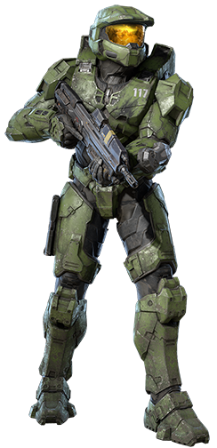


Now let's create a lot of these variations

Slide 6
Let’s have them fight
Simons’ were intentionally harmed

Slide 7
Score them
Health: 0
Damage done: 0
Score = -10
Using a fitness function
Health: 0
Damage done: 0
Score = -10
Health: 80
Damage done: 60
Score = 120
.
.
.

Slide 8
Let’s Sort them

Slide 9
The Best one survive
* Elitism

Slide 10

The better ones get mutated

Slide 11
We Kindly* let go of bad agents

Slide 12
We Kindly* let go of bad agents

Slide 13
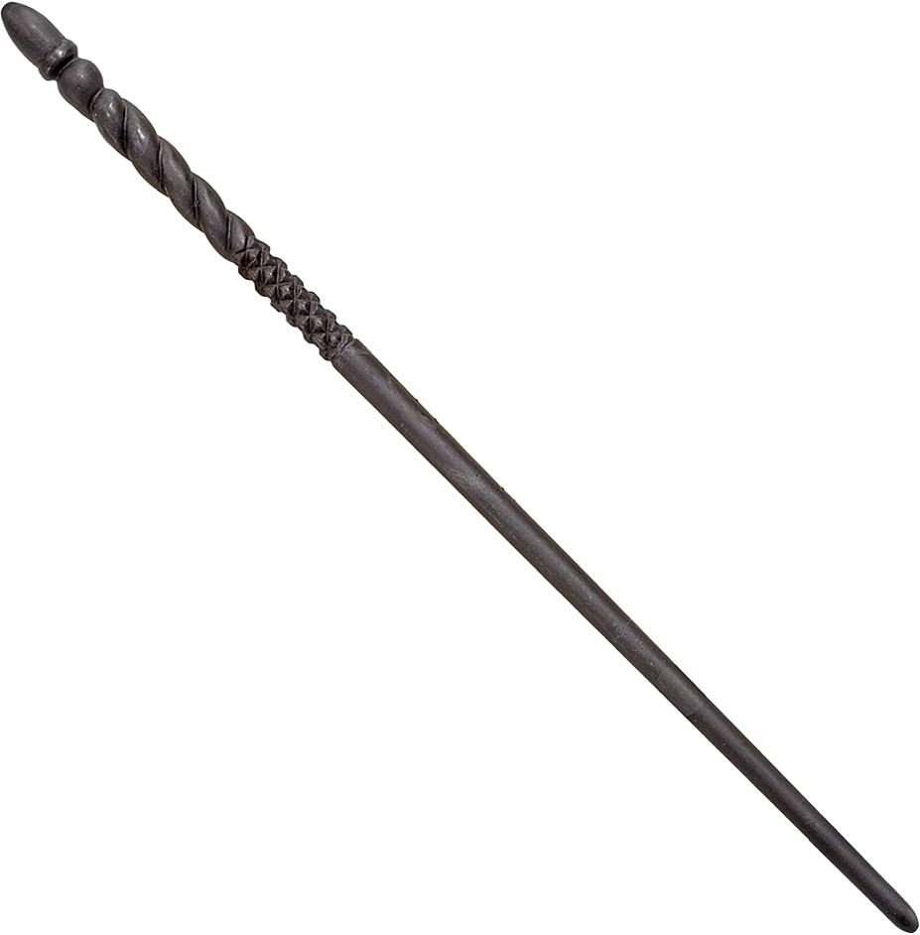
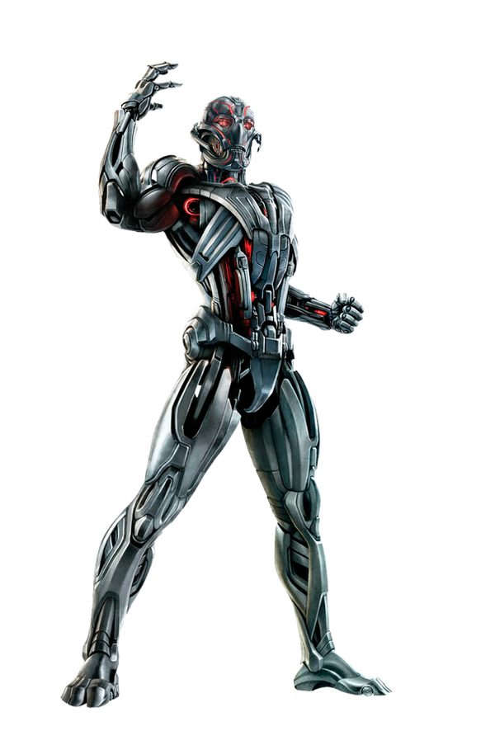
And new agents take it place

Slide 14
And then we repeat the same for the next generation

Slide 15
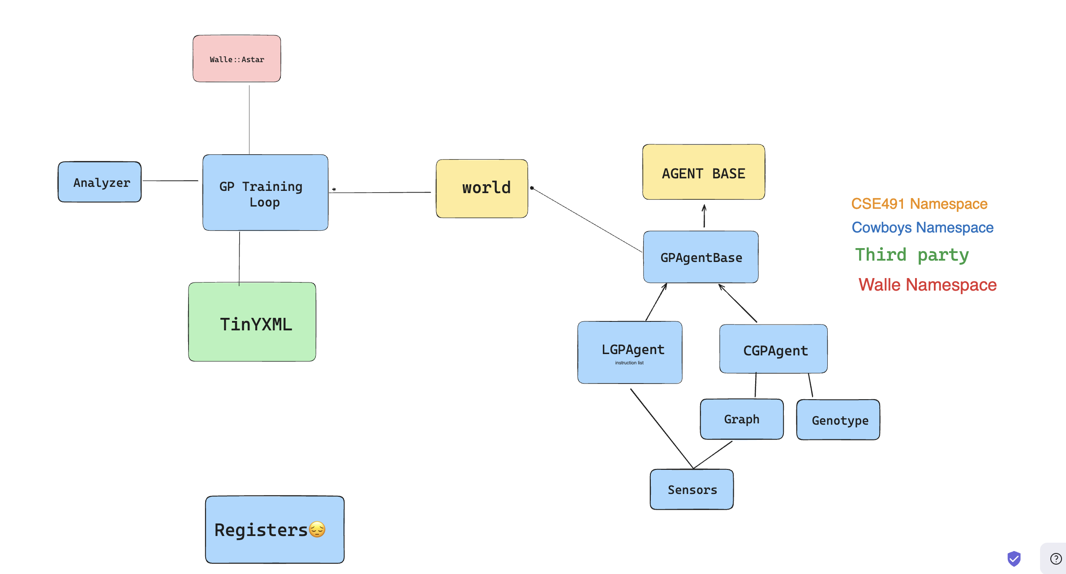
Our Design
Notes:
Rajmeet

Slide 16
CGPAgent
(Cartesian Genetic Programming)
Notes:
SImon

Slide 17
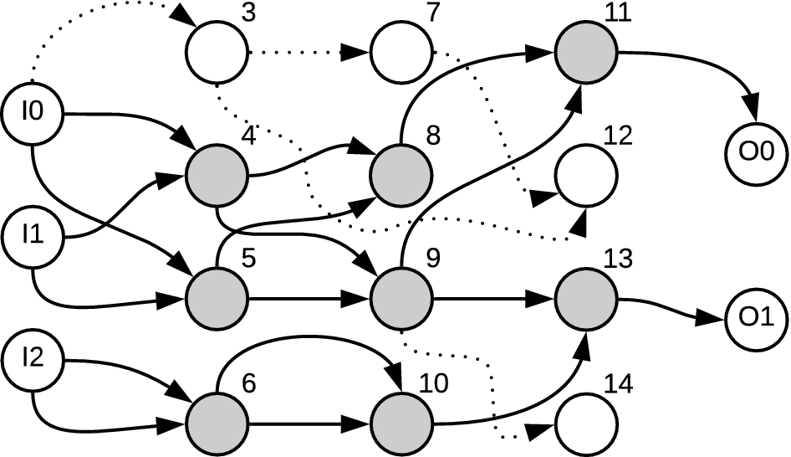
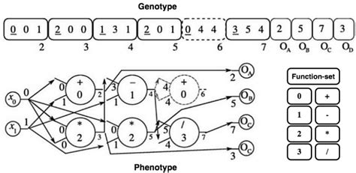
The idea
Credit: Mitchell Spryn
Credit: Miragaia et al.

Slide 18
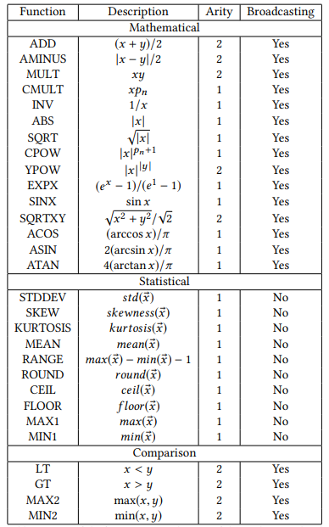
Function Set
Credit: Evolving simple programs for playing Atari games by Wilson et al.

Slide 19
Function Set
What we used:
Sum
Product
Sin
Cos
Exp
Max
Min
And many more
Credit: Evolving simple programs for playing Atari games by Wilson et al.

Slide 20
Function Set
What we used:
Sum
Product
Sin
Cos
Exp
Max
Min
And many more
And sensors:
Distance to nearest walls in each cardinal direction
A* Distance
Credit: Evolving simple programs for playing Atari games by Wilson et al.

Slide 21
LGP Agent
(Linear Genetic Programming)
Notes:
Jason

Slide 22
How it works
Three primary data structures:
Instruction list
Results list
Index of current instruction

Slide 23
How it works
Three primary data structures:
Instruction list
Results list
Index of current instruction
Three types of instructions:
Sensors
Operations
Actions

Slide 24
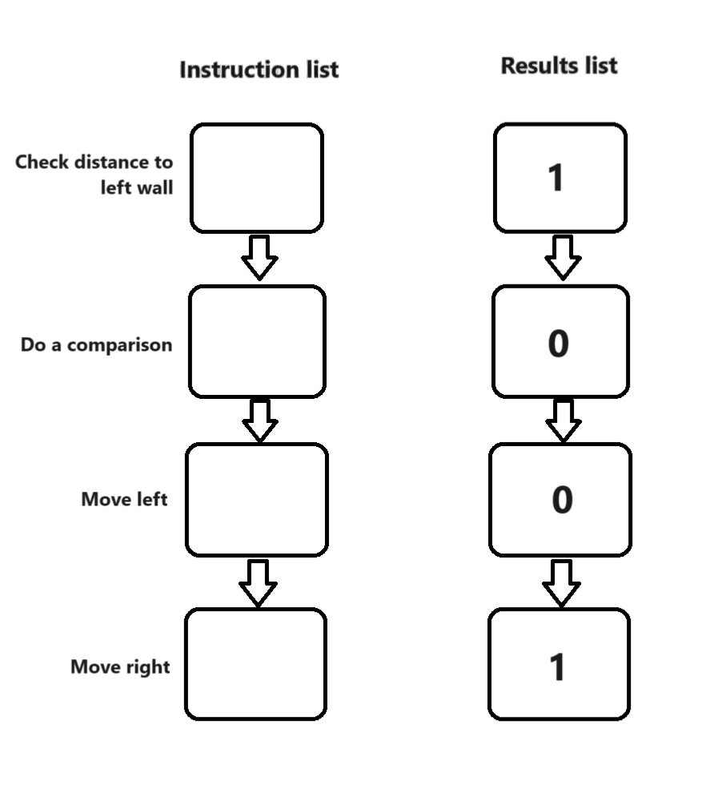
How it works
Three primary data structures:
Instruction list
Results list
Index of current instruction
Three types of instructions:
Sensors
Operations
Actions

Slide 25
How it works
Three primary data structures:
Instruction list
Results list
Index of current instruction
Mutating is very easy!
Runs very quickly!
Downside?
Three types of instructions:
Sensors
Operations
Actions

Slide 26
Genetic Programing Loop

Slide 27
Tasks that GP Loop is responsible for
Instantiation
Scoring agents
Mutating Agents
Running Worlds

Slide 28

The power of multi threading
Notes:
245.91 seconds -> 1 thread
46.88 seconds -> 12 threads

Slide 29

Multi Threading Design🧵
Notes:
https://emojiterra.com/stadium/

Slide 30
Multi Threading Design🧵
Thread 1
Thread 2
Thread 3
Notes:
https://emojiterra.com/stadium/

Slide 31
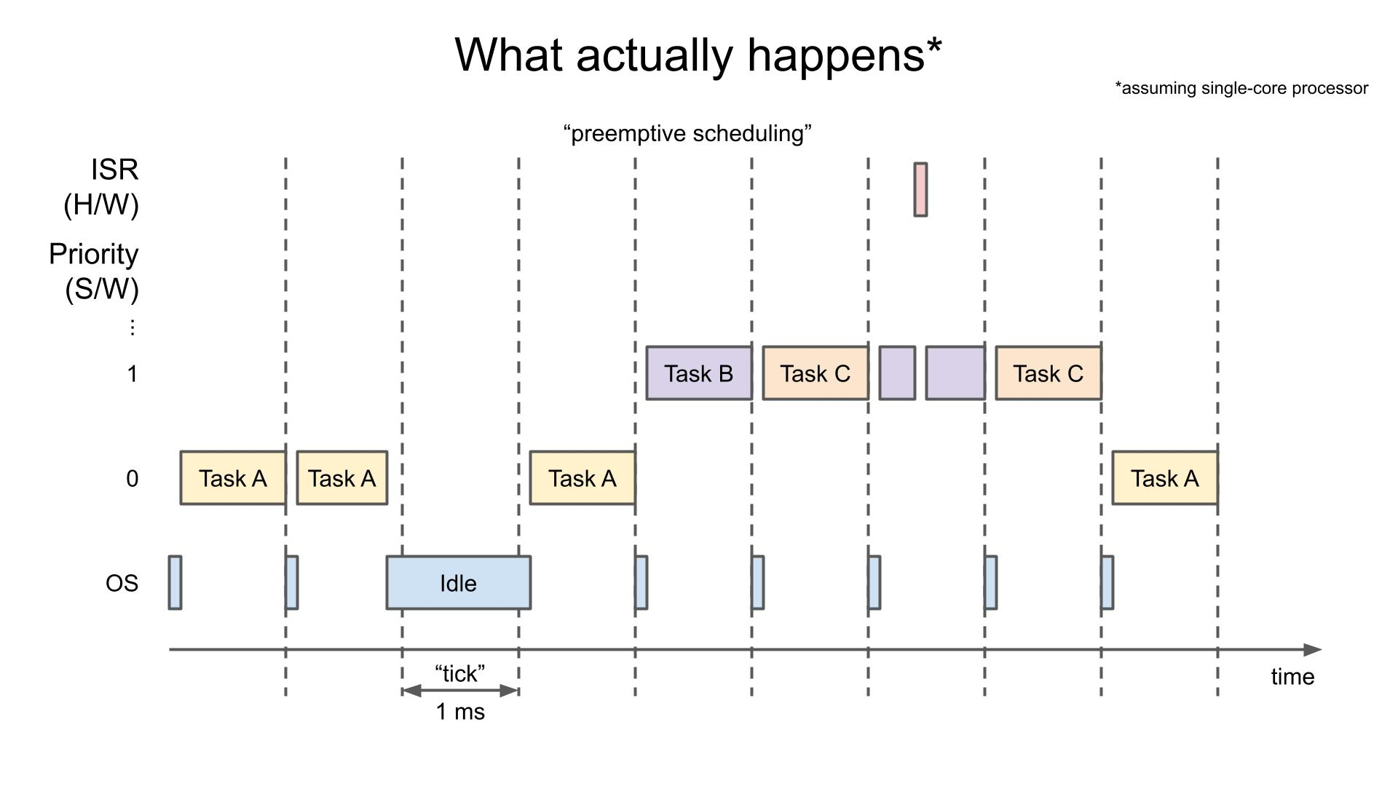
Scavenger Queuing / Checkpointing
Image from https://www.digikey.com/en/maker/projects/introduction-to-rtos-solution-to-part-3-task-scheduling/8fbb9e0b0eed4279a2dd698f02ce125f

Slide 32
Demo

Slide 33
Is the program really evolving?
Yeah, trust us bro!
16 arenas
1000 agents
100 generations

Slide 34
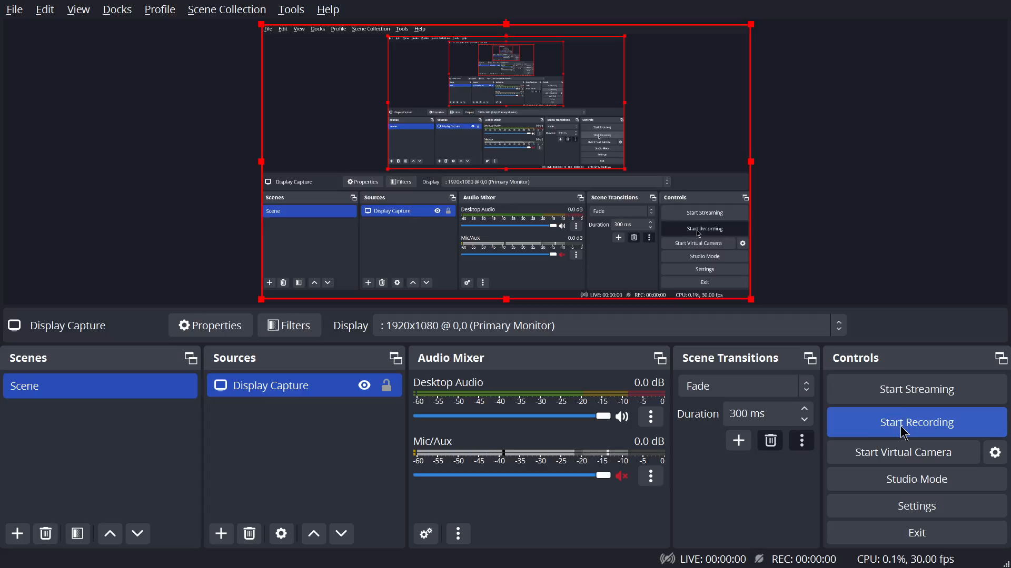
Metrics: Average Fitness
Notes:
The "average fitness" would be the mean fitness score of all individuals in a given generation. A higher average fitness usually indicates that the population, on average, is better at solving the problem

Slide 35
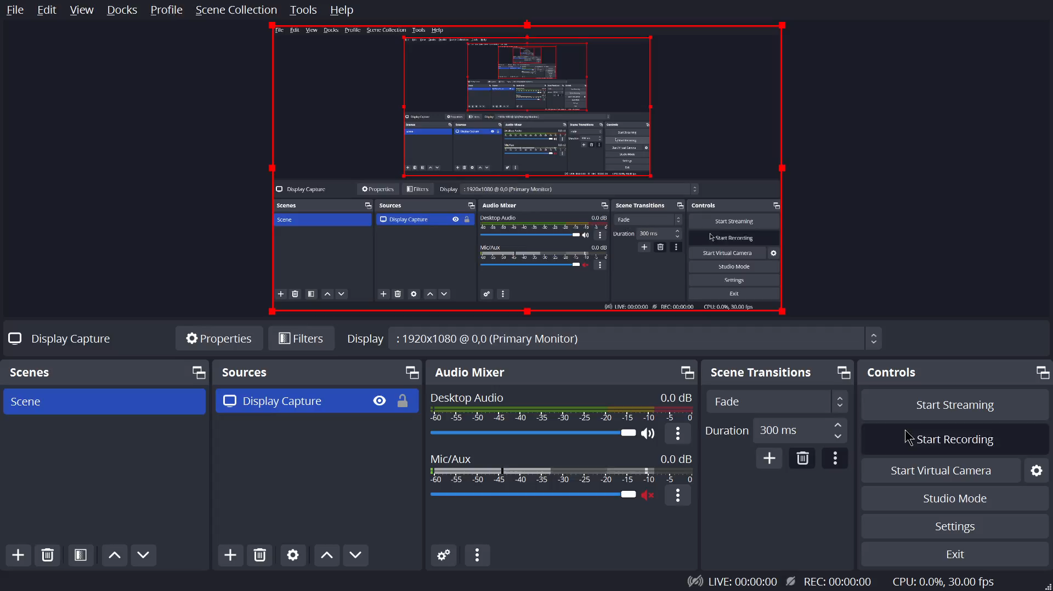
Metrics: Max Fitness
Notes:
This is likely the fitness score of the best individual in the population for a given generation. It represents the peak performance of the population at that point in time.

Slide 36
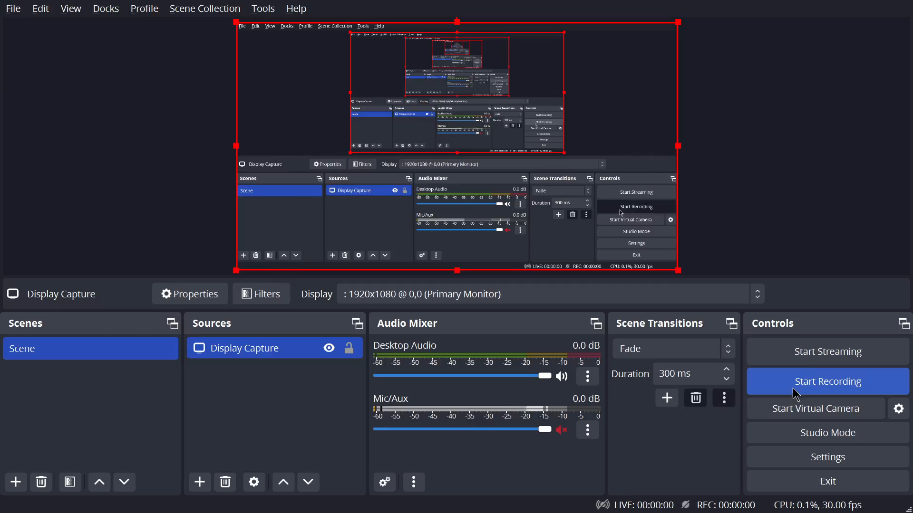
Metrics: Average Elite Score
Notes:
How the the top elite unchanged population is doing on average

Slide 37

Metrics: Best Agent Weighted Score

Slide 38
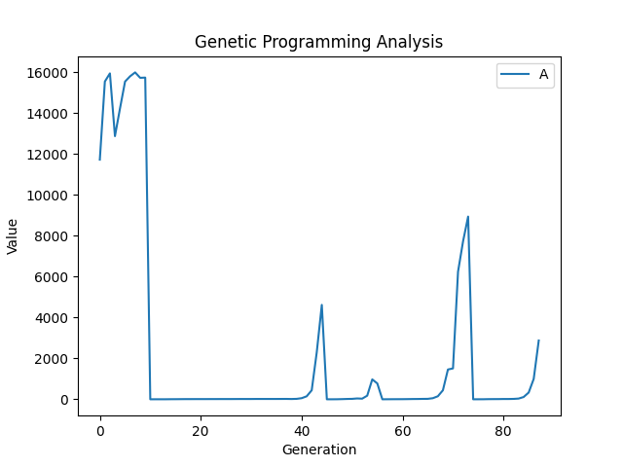
Metrics: Number Best Agents with max fitness

Slide 39
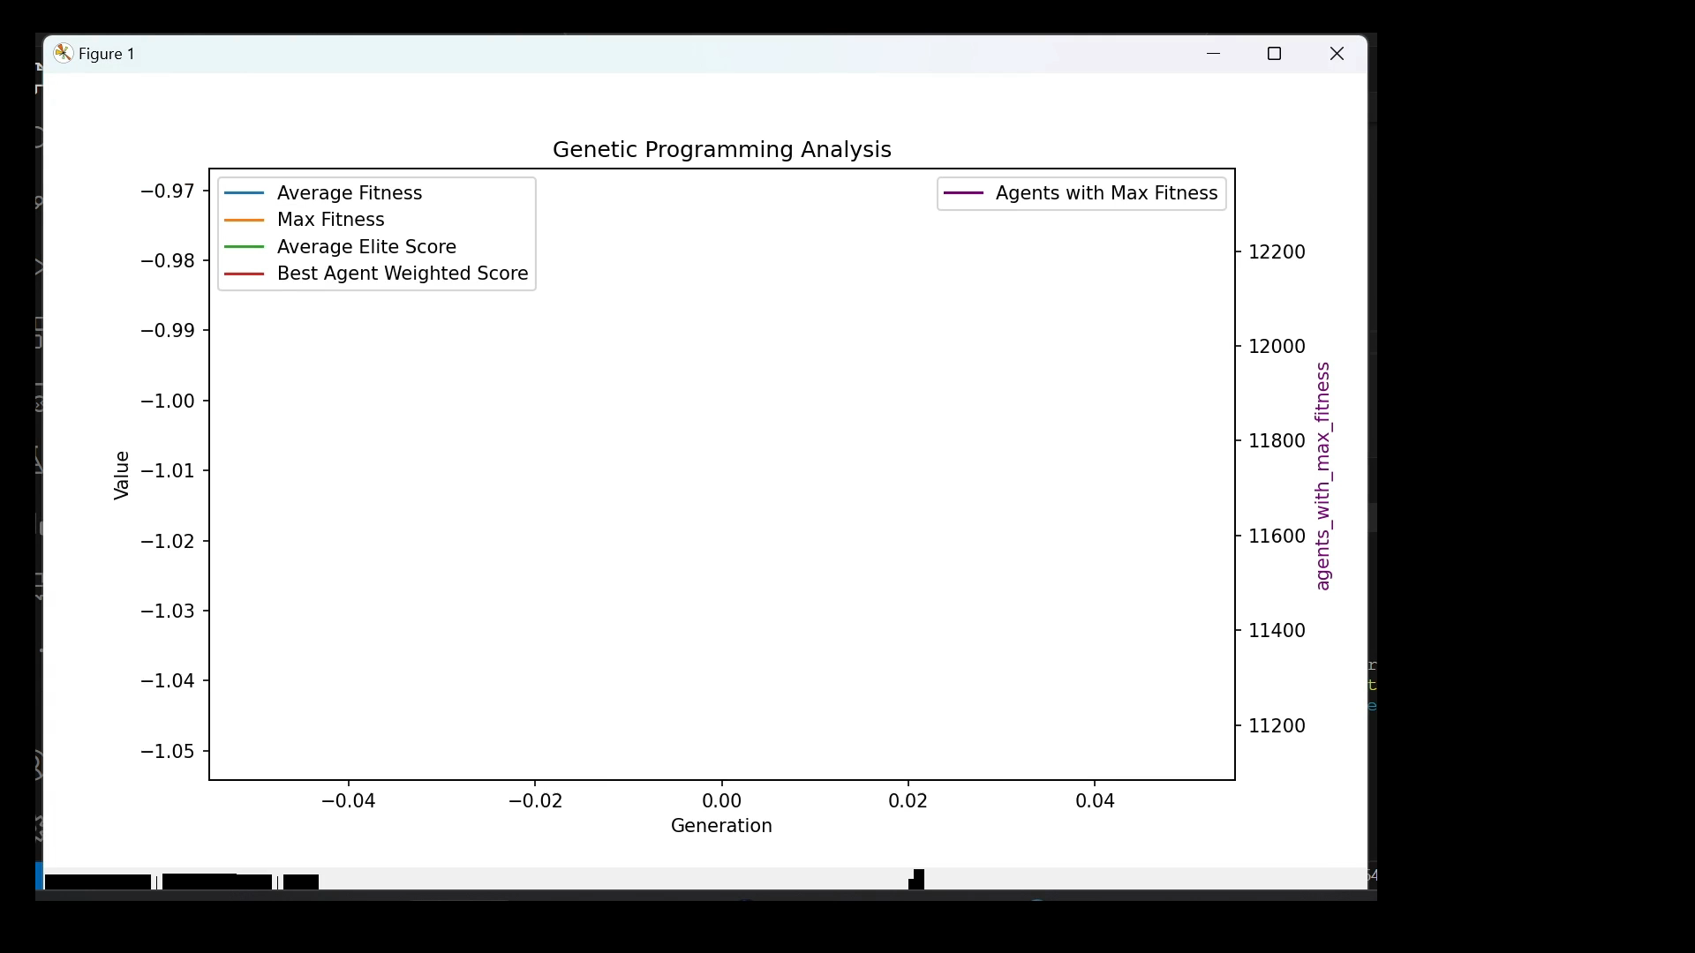
Let’s have fun

Slide 40
Does our code work well?
Hell, Yeah it does
(at least on my computer)

Slide 41
Sanitizers
Google Sanitizers
Address Sanitizer (ASan)
Leak Sanitizer (LSan)
Thread Sanitizer (TSan)
Undefined Behavior Sanitizer (UBSsan)
Memory Sanitizer (MSan)
Valgrind

Slide 42
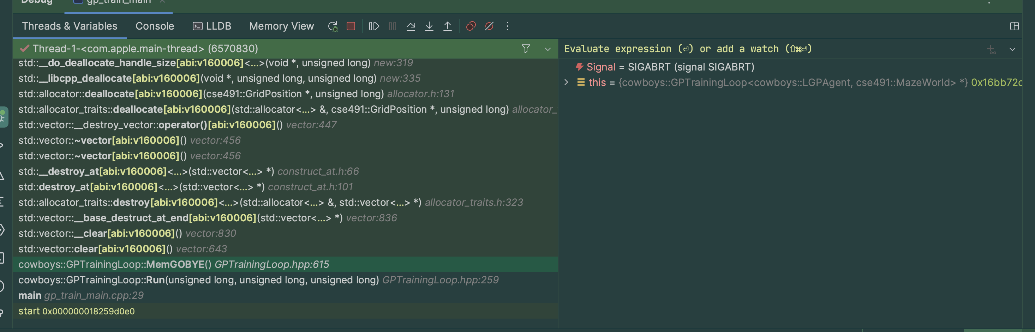
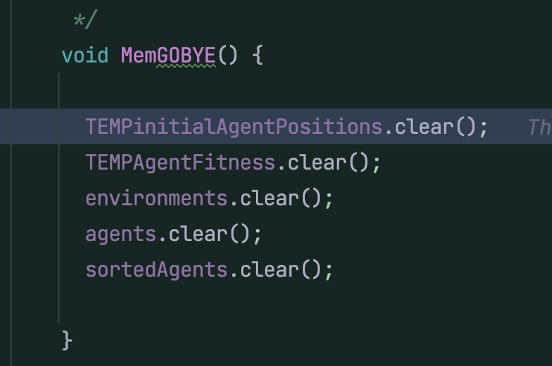
Runtime Errors

Slide 43
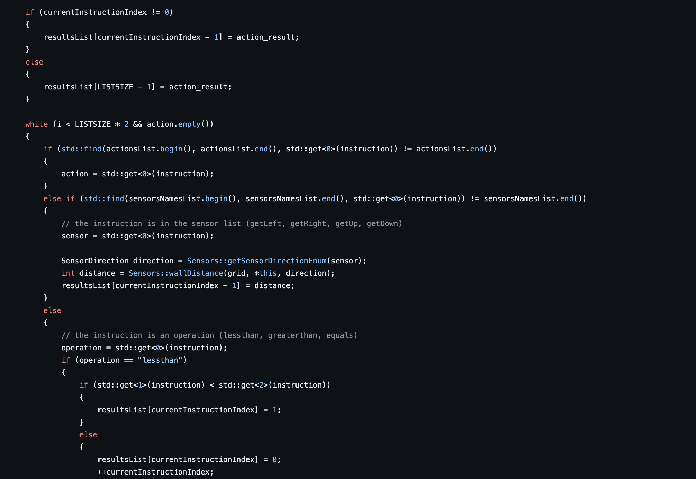

Slide 44

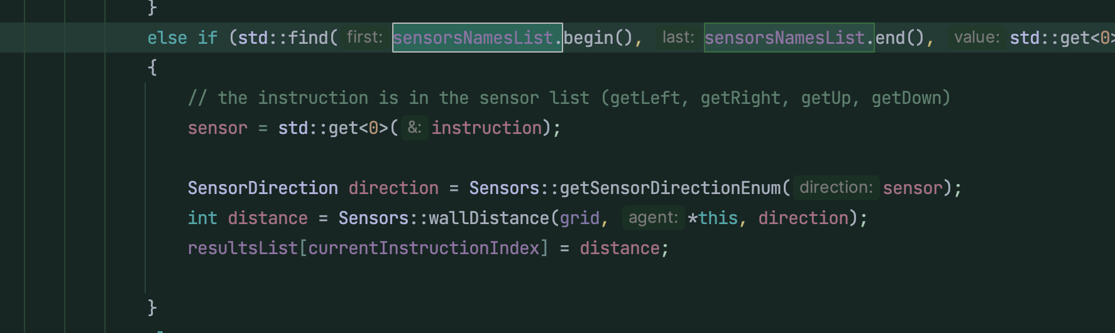
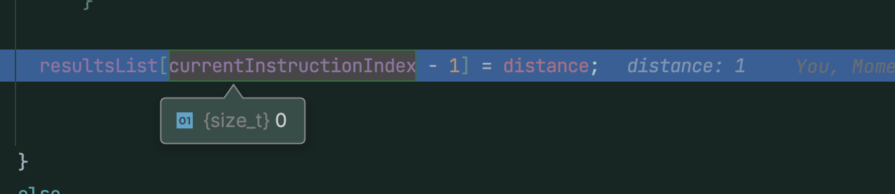
Fixed a UB!

Slide 45
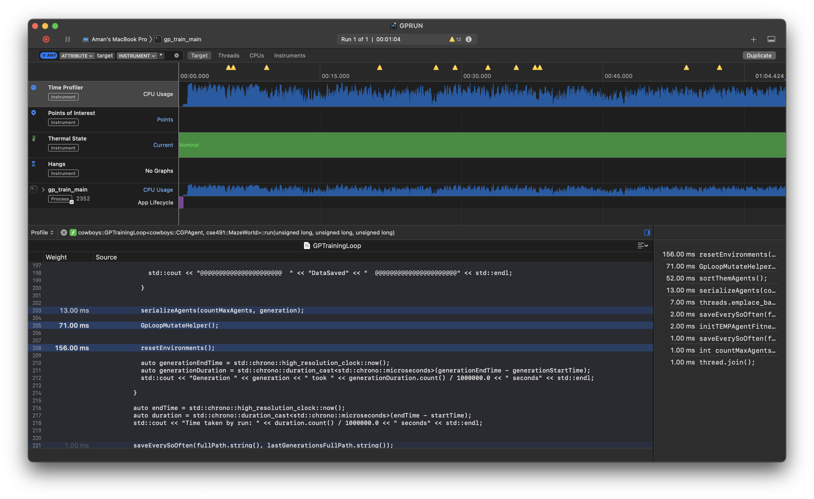
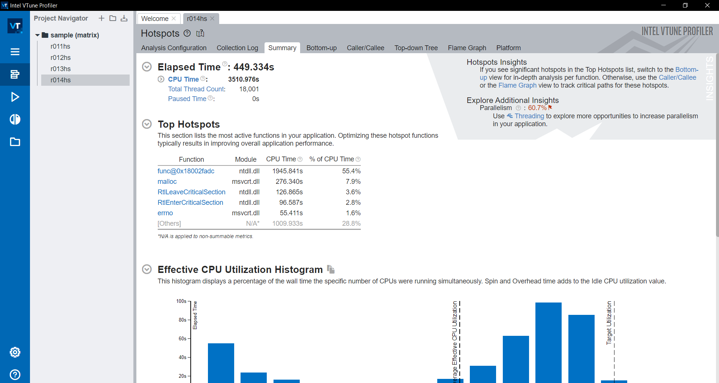
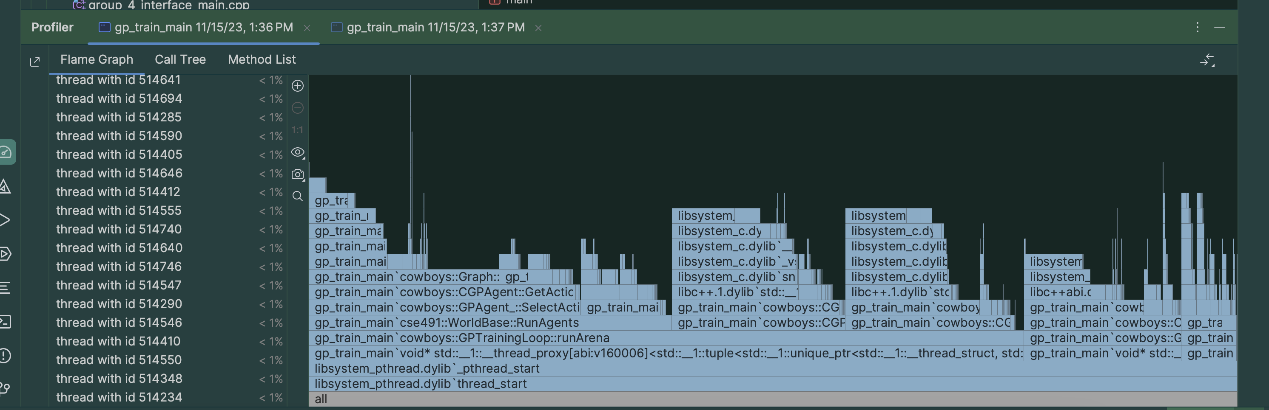
We profiled to make things efficient

Slide 46
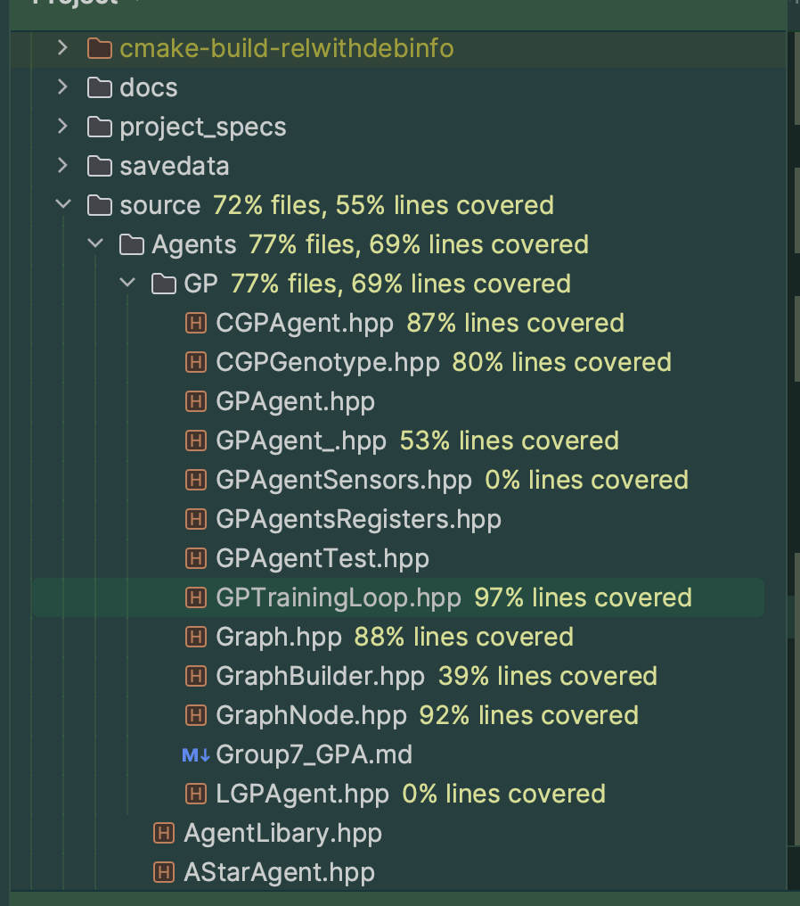
Coverage Checks

Slide 47
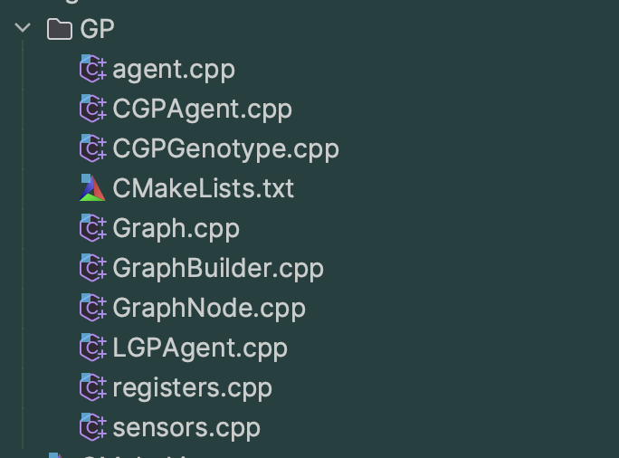
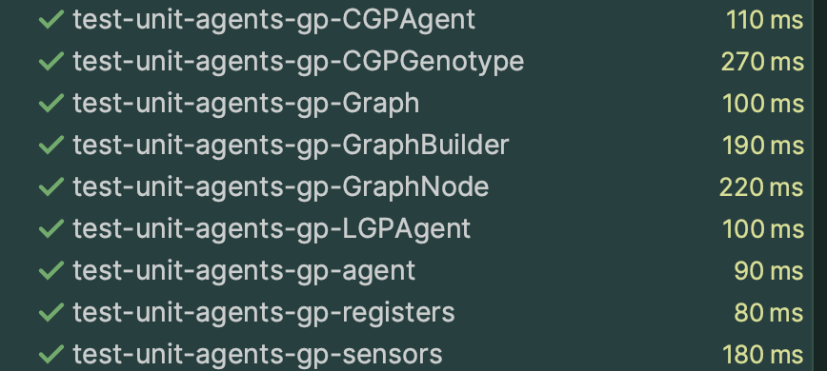
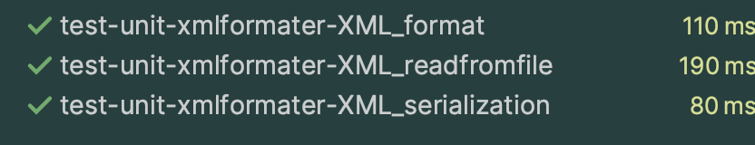
Unit Tests

Slide 48

Main Demo

Slide 49
Problems that we might face
Restart seeding
Seeding Determinism
Agents Getting stuck at local minimum

Slide 50
Potential Future Improvements
Better/different fitness functions for more specialized behaviors
Deploy in HPCC
Integration Testing?

Slide 51
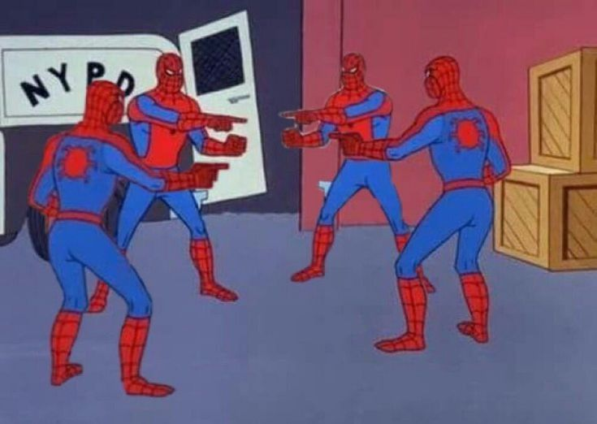
Who to blame if things don’t work
Notes:
Aman

Slide 52
www.deviantart.com/
https://pngimg.com/image/104752

Slide 53


Slide 54


